Slide 1
Java Strings

Slide 2
Java Strings
Strings are used for storing text.
A String variable contains a collection of characters surrounded by double quote.
String greeting = "Hello";
A String in Java is actually an object, which contain methods that can perform certain operations on strings

Slide 3
Methods Java Strings
The length of a string can be found with the length() method
There are many string methods available, for example toUpperCase() and toLowerCase(); allows to leave all text in uppercase or lowercase letters
The indexOf() method returns The index (the position) of the first occurrence of a specified text in a string (including whitespace)

Slide 4
String Concatenation
The + operator can be used between strings to combine them. This is called concatenation:
String firstName = "John";
String lastName = "Doe";
System.out.println(firstName + " " + lastName);

Slide 5
String Concatenation
(firstName.concat(lastName))
You can also use the concat() method to concatenate two strings:
String firstName = "John";
String lastName = "Doe";
System.out.println(firstName.concat(lastName));

Slide 6
Adding Numbers and Strings
If you add two numbers, the result will be a number:
int x = 10;
int y = 20;
int z = x + y; // z will be 30 (an integer/number)
If you add two strings, the result will be a string concatenation:
String x = "10";
String y = "20";
String z = x + y; // z will be 1020 (a String)

Slide 7
Adding Numbers and Strings
If you add a number and a string, the result will be a string concatenation:
String x = "10";
int y = 20;
String z = x + y; // z will be 1020 (a String)

Slide 8
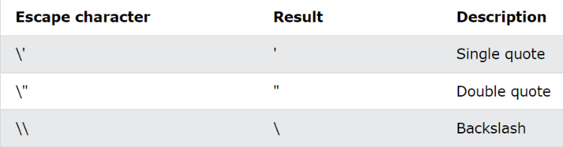
Special Characters
Because strings must be written within quotes, Java will misunderstand this string, and generate an error:
String txt = "We are t
he so-called "Vikings" from the north.";
The solution to avoid this problem, is to use the backslash escape character.
The backslash (\) escape character turns special characters into string characters:

Slide 9
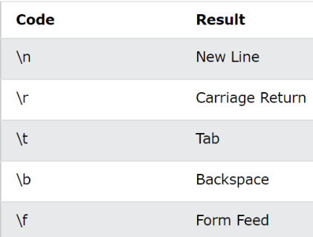
Special Characters
Other common escape sequences that are valid in Java are:

